Slide 2
Azure Best Practices Architecting Complex Solutions with Heavy Loads
Damir Dobric

Slide 3
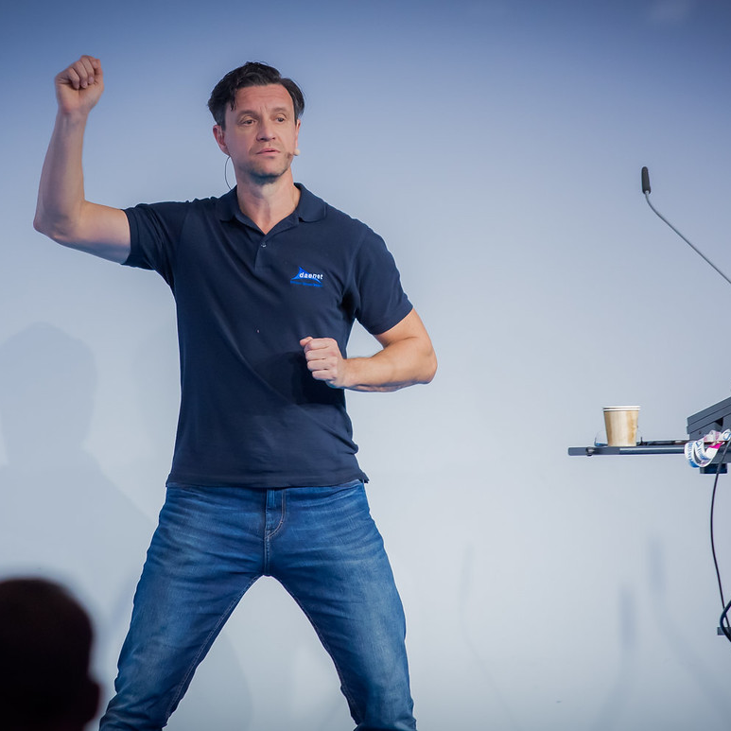

Damir Dobric daenet GmbH – ACP Digital Lead Software Architect Microsoft Regional Director Azure MVP https://damirdobric.me
Notes:
Single presenter
Each speaker introduces themselves and provides fun fact or superpower.

Slide 4
Agenda
Hosting Large Objects
The Object Pool Pattern
Relativity Theory of Load Balancing
Deep Dive Demos
Q&A

Slide 5
HIDDEN PAINS OF CLOUD

Slide 6
Imagine following…
Your Goal
Digital Transformation
Application Modernization
Migration to cloud
New business models
Scenarios
ML Model that consumes too much RAM
An API that consumes too much RAM
var api = new MyApi(arg);
var res = await api.Run();

Slide 7
Locking for solution
Facts
Large APIs consume a lot of RAM
Not designed to run in the cloud
You want to run it as a service = REST service
Few API instances cannot serve many users
What to do?
Increase Vertically/Horizontally means an increase in costs
It is not easy to choose the right configuration
[HttpGet("{arg}")]
public async Task<string> Run(int arg)
{
var api = new MyApi(arg);
var res = await api.Run();
return res;
}
https://github.com/ddobric/azure-bestpractices

Slide 8
Processing of requests in ASP.NET WebApi
Thread
Object
Thread
Object
Thread
Object
Thread
Object
Thread
Object
Thread
Object
HTTPS Requests
Thread
Object
Thread
Object
Thread
Object
Thread
Object
Thread
Object
Thread
Object
Thread
Object
Thread
Object
[HttpGet("{arg}")]
public async Task<string> Run(int arg)
{
var obj = new MyApi(arg);
var res = await obj.Run();
return res;
}

Slide 9
Processing Large objects
Object
Thread
Object
HTTPS Requests
Thread
Object
Thread

Slide 10
Docker Host does not like such scenarios
Exit Code 134
Abnormal termination (SIGABRT)
Container Abnormally Terminated itself
Status Out of Memory
Exit Code 137
Immediate Termination (SIGKILL)
Docker Kill
Status OOMKilled

Slide 11
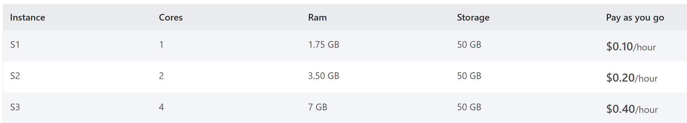
An example
Your API consumes (just) 1 GB RAM.
You have 100+ concurrent users.
2 instances in 3.5GB
100/2*144 EUR/month=7200 EUR/Month
(072)
(144)
(288)

Slide 12
THE OBJECT POOL PATTERN

Slide 13
Object Pool Pattern
ASP.NET WebApi
Thread 1
Object
Thread 2
HTTPS Requests
Object
Thread 3
Object
Thread 4

Slide 14
Object Pool Pattern
ASP.NET WebApi
Thread 1
Object
Thread 2
HTTPS Requests
Object
Thread 3
Object
Thread 4

Slide 15
Object Pool Pattern
ASP.NET WebApi
Thread 1
Object
Thread 2
Object
HTTPS Requests
Thread 3
Object
Thread 4

Slide 16
Object Pool Pattern
ASP.NET WebApi
Thread 1
Object
Thread 2
Object
HTTPS Requests
Thread 3
Object
Thread 4

Slide 17
RELATIVITY THEORY OF THE LOAD BALANCING

Slide 18

Cost Saving by prolonging request time
Memory (space)
Request processing (time)
SERVICE
Time Dilation
You can save the space if you slower the processing time

Slide 19
WebServer will reject requests on high load
The server will reject requests with ERR:500 (Internal Server Error)
ASP.NET WebApi
Thread 1
Object
WebServer / ASP.NET
Request Queue
Thread 2
Object
Thread 3
Object
Thread 4
You take control and return custom busy error
ERR:410 (Gone)

Slide 20
Object Pool Pattern with the “request queue”
ASP.NET WebApi
Thread 1
Object
Thread 2
Object
HTTPS Requests
Thread 3
Object
Thread 4

Slide 21
Object Pool Pattern with “request queue”
ASP.NET WebApi
Thread 1
Object
Thread 2
Object
HTTPS Requests
Thread 3
Object
Thread 4

Slide 22
Object Pool Pattern with “request queue”
ASP.NET WebApi
Thread 5
Thread 2
Object
HTTPS Requests
Thread 3
Object
Thread 4
Object

Slide 23
This really works ☺

Slide 24
Summary
Large objects consume an unpredictable amount of RAM.
Docker Host terminates your code with Err 134 and 137.
You can implement Object Pool = Large Objects as a Service
You can keep the size and costs, but you must slow down processing (time dilation).
https://github.com/ddobric/azure-bestpractices

Slide 25

Vielen Dank!
Vielen Dank für deine Teilnahme!
Dein Feedback ist uns wichtig! Bitte besuche aka.ms/MicrosoftBuildEvals, um deine Session-Bewertungen auszufüllen.​
Damir Dobric daenet GmbH – ACP Digital Lead Software Architect Microsoft Regional Director Azure MVP https://damirdobric.me
Notes:
For long resource links, create a shortened link at aka.ms
Paste the resource links into the meeting chat as an “Announcement” so attendees can copy/use them
To continue the conversation, re-post the team’s social handles or other methods of connecting
COPY/PASTE

